Slide 1
WIL 2 PRESENTATION
Summation of documents & Program demonstration

Slide 2
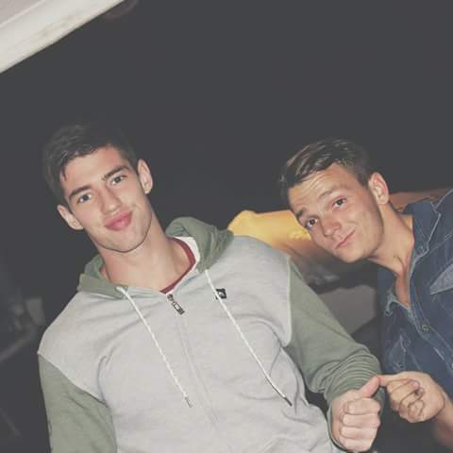
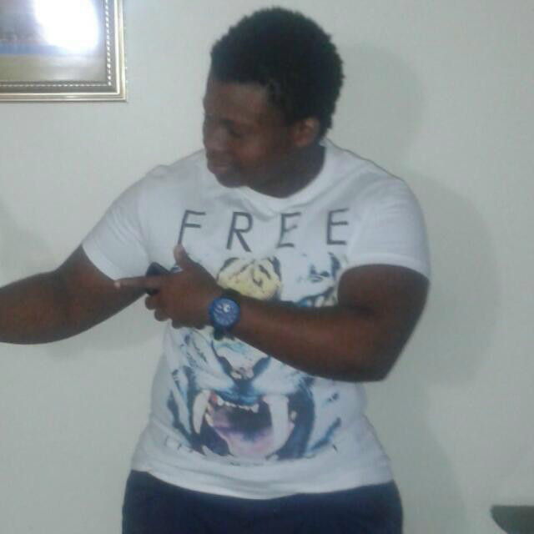
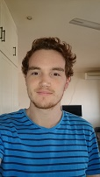
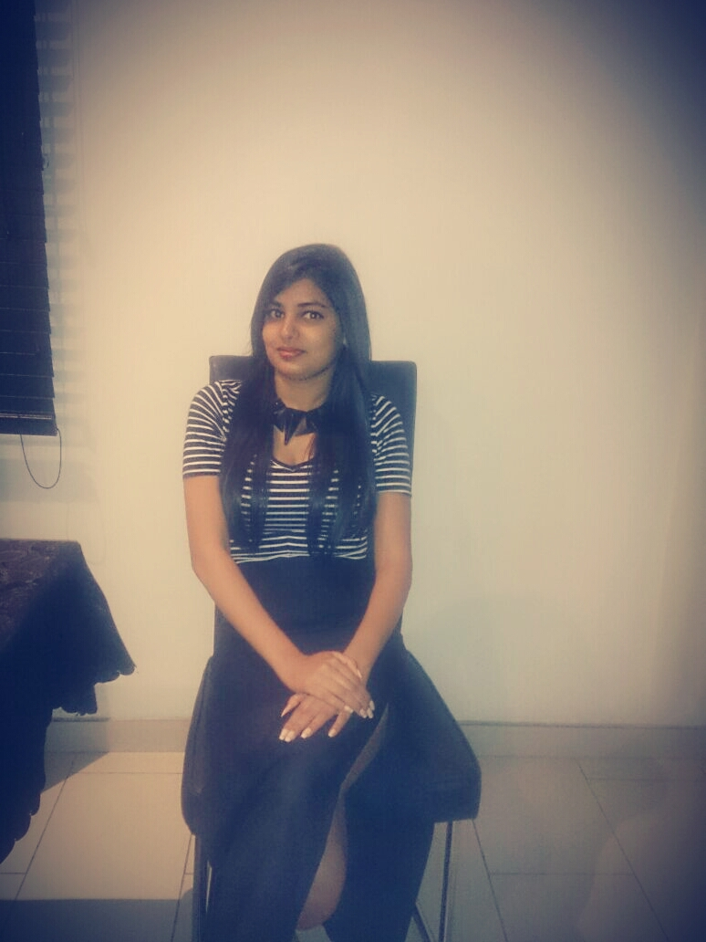
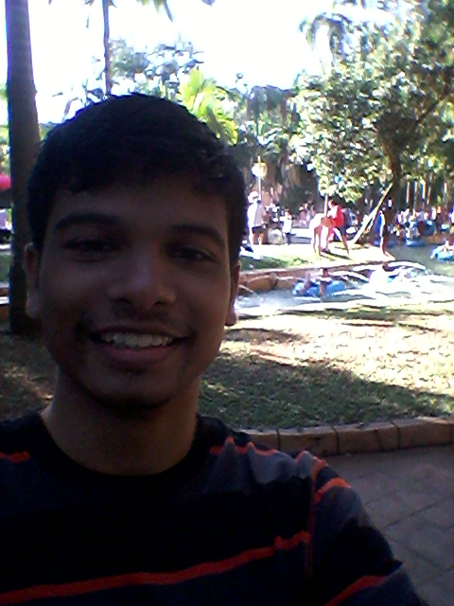
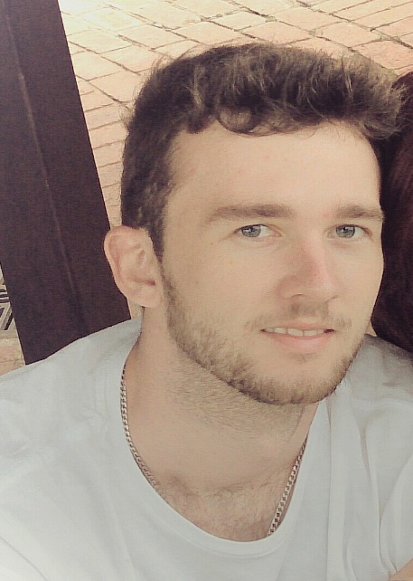
INTRODUCTION OF TEAM MEMBERS
Duran Moodley
Matthew Harmsworth
Lunga Magadla
Calvin Reed
Mishka Ramburan
Matt Hutchings
Together we form Express Cor

Slide 3
CONTENTS OF PRESENTATION
INTRODUCTION OF TEAM MEMBERS
PROBLEM DOMAIN (CUSTOMER NEEDS AND SATISFACTION)
RISKS + BENEFITS OF THE PROJECT
LOGICAL ARCHITECTURAL DESIGN
DATABASE DESIGN (TABLE STRUCTURE)
FUNCTIONALITY OF THE SYSTEM
DEMONSTRATION OF THE SYSTEM
TEAM LEADER REFELECTION

Slide 4
PROBLEM DOMAIN
The client and their needs
The program needs to fix errors which are problematic to the business
Produce a total of 7 reports
Vehicle Status Report
Daily and weekly service appointment list
Service Requirement job sheet
Daily, weekly, monthly and yearly report on completed vehicle services
Specific service report
Daily/weekly planned trip report
Daily/ weekly/monthly completed trip report
Daily/weekly/monthly time sheet report detailing how many hours each person worked

Slide 5
Risks of the project
There were many risks in the project.
The main risks that we felt were:
Exceeding the proposed budget
Load sheading (you never know with Eskom)
Shared Drive being hacked

Slide 6
Benefits of the Project
Benefits for the customer if project is successful
Save costs
Budget accurately
Keep track of business processes
Save time
Improve the lifespan of vehicle
Save the reputation of the Company

Slide 7
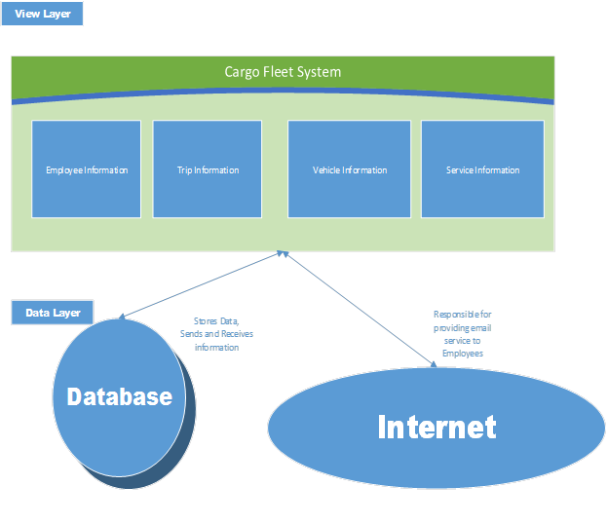
Logical Architectural Design
High Level Design
Low Level Design

Slide 8
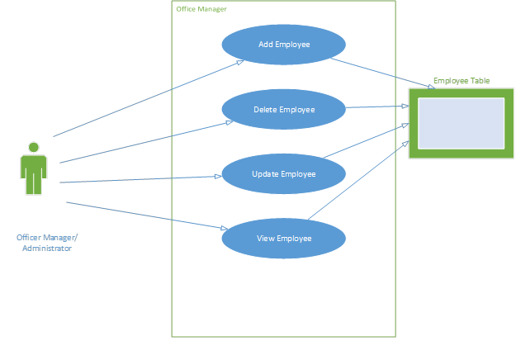
Logical Architectural Design (Continued)
Actors
Office Manager
Trip Manager
Service Manager
Timesheet Manager
Vehicle Information Administrator
Mechanic
Driver

Slide 9
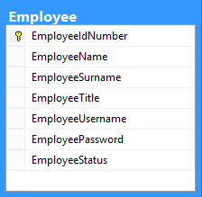
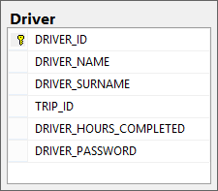
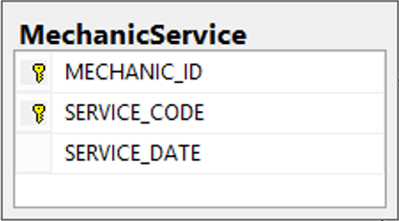
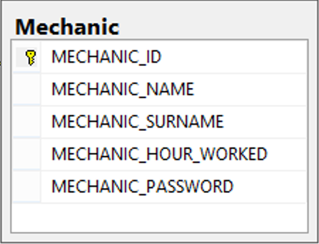


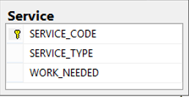
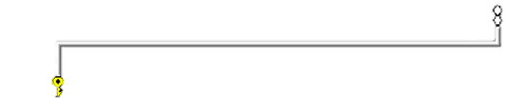
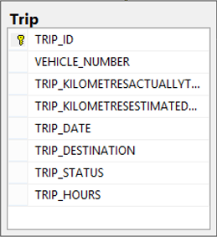
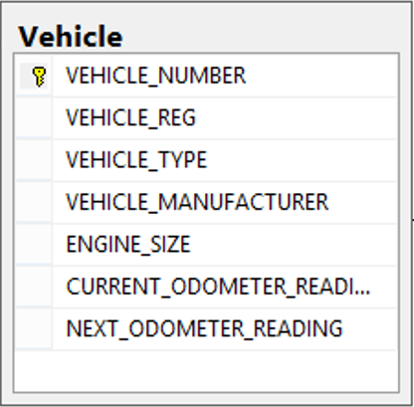


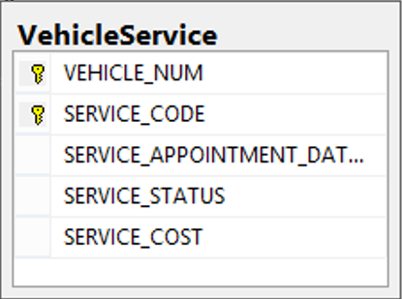

Database Design

Slide 10
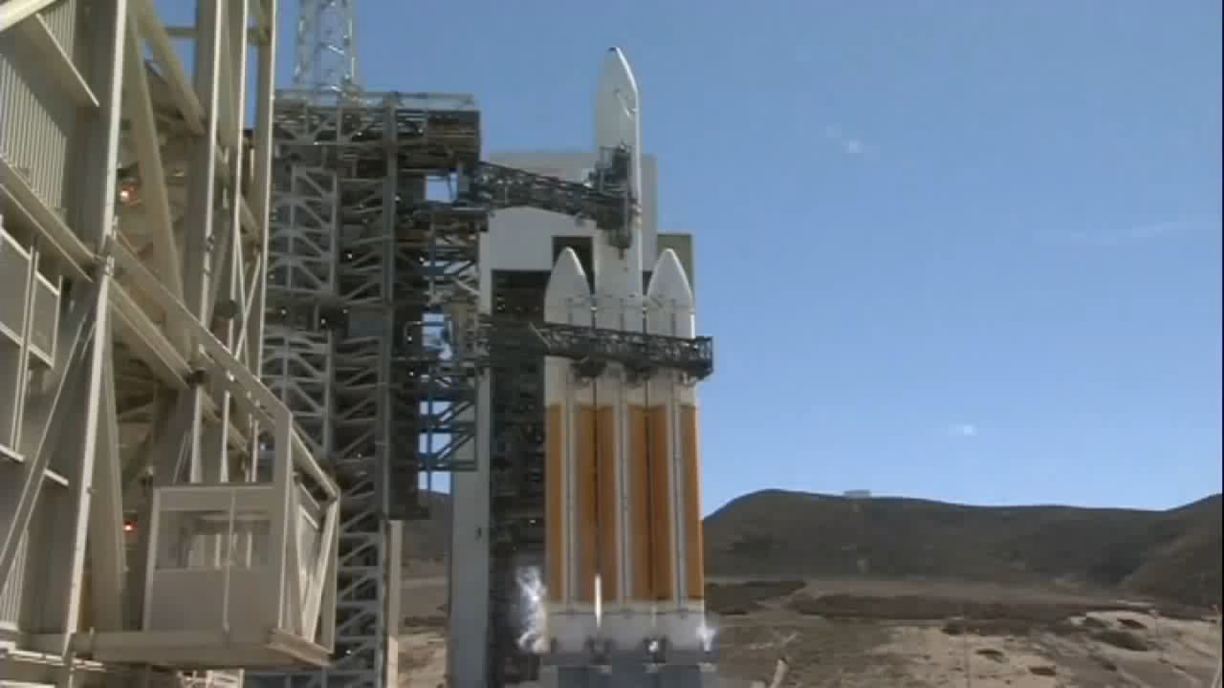
Launching of our system

Slide 11
Summary of System Functionality
Add , Delete , Update and View reports
Employees
Vehicles
The following do not have a Delete function
Services
Trips
Additional functionality
Password Recovery through Email

Slide 12
Future Plans for the Program
Allow the application to connect to a web service and retrieve information of the weather for a particular trips destination on a specific day
We’d like to added in fuel expenses for each trip
The user will be able to sign up through the application.
Reset user password

Slide 13
The Development Process
We used an agile development approach
We took into consideration human computer interaction
Usable product
User friendly
Provide a positive user experience

Slide 14
Team Leader Reflection
We met project requirements
We did not run over time with project.
Therefore, the project is a success.

Slide 15

Thank you for listening to us

